Slide 1
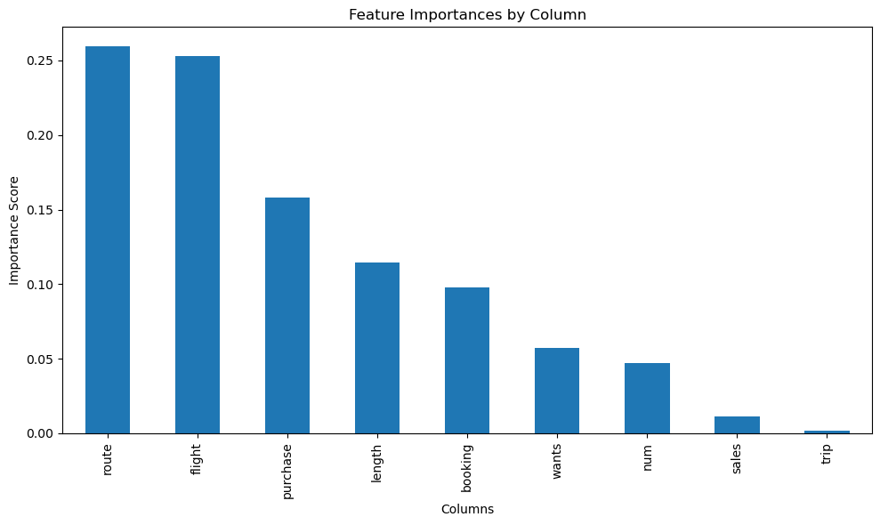
Random forest predictive model evaluation for customer bookings British Airways
The Classifier was trained to predict whether a customer booking would be completed (`booking_complete`). The model used all available features, with categorical variables by One Hot Ecoding. The dataset was split into training and test sets (80/20 split).
Precision: Proportion of positive identifications that were actually correct.
Recall: Proportion of actual positives that were identified correctly.
F1-score: Harmonic mean of precision and recall.
Support: Number of occurrences of each class in the test set.
precision | recall | f1-score | support
0.87 | 0.98 | 0.92 | 8520
0.52 | 0.14 | 0.22 | 1480
0.85 | 0.85 | 0.85 | 0.85
0.69 | 0.56 | 0.57 | 10000
0.82 | 0.85 | 0.82 | 10000

Slide 2
